Slide 1
Cyberphysical Systems: Invariants
Sayan Mitra
Verifying cyberphysical systems
mitras@illinois.edu

Slide 2
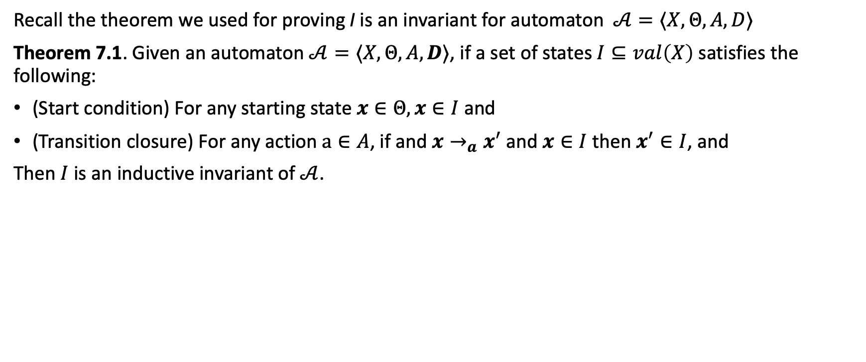
How to prove invariants of hybrid automata
Recall the theorem we used for proving I is an invariant for automaton$𝒜=⟨X,Θ, A,D⟩$
Theorem 7.1. Given an automaton $𝒜=⟨X,Θ, A,D⟩$, if a set of states $I⊆val\left(X\right)$ satisfies the following:
(Start condition) For any starting state $x∈Θ, x∈I$ and
(Transition closure) For any action $a∈A$, if and $x→_{a}x^{′}$and $x∈I$ then $x^{′}∈I$, and
Then $I$ is an inductive invariant of $𝒜$.

Slide 3
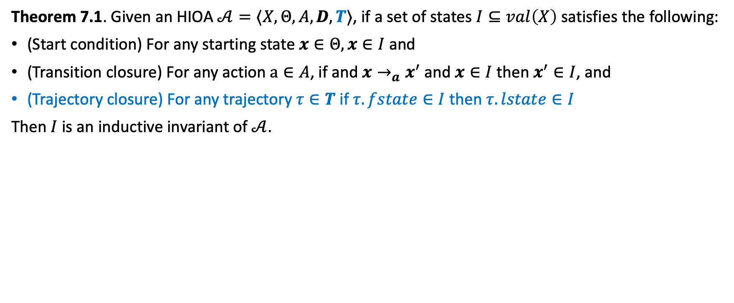
How to prove invariants of hybrid automata
Theorem 7.1. Given an HIOA $𝒜=⟨X,Θ, A,D, T⟩$, if a set of states $I⊆val\left(X\right)$ satisfies the following:
(Start condition) For any starting state $x∈Θ, x∈I$ and
(Transition closure) For any action $a∈A$, if and $x→_{a}x^{′}$and $x∈I$ then $x^{′}∈I$, and
(Trajectory closure) For any trajectory $τ∈T$ if $τ.fstate∈I$ then $τ.lstate∈I$
Then $I$ is an inductive invariant of $𝒜$.

Slide 4
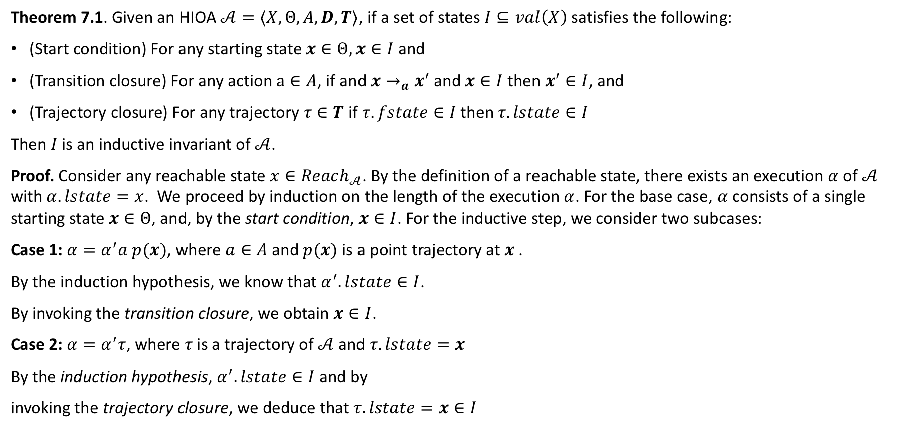
How to prove invariants of hybrid automata
Theorem 7.1. Given an HIOA $𝒜=⟨X,Θ, A,D, T⟩$, if a set of states $I⊆val\left(X\right)$ satisfies the following:
(Start condition) For any starting state $x∈Θ, x∈I$ and
(Transition closure) For any action $a∈A$, if and $x→_{a}x^{′}$and $x∈I$ then $x^{′}∈I$, and
(Trajectory closure) For any trajectory $τ∈T$ if $τ.fstate∈I$ then $τ.lstate∈I$
Then $I$ is an inductive invariant of $𝒜$.
Proof. Consider any reachable state $x∈Reach_{𝒜}$. By the definition of a reachable state, there exists an execution $α$ of $𝒜$ with $α.lstate=x$. We proceed by induction on the length of the execution $α$. For the base case, $α$consists of a single starting state $x∈Θ$, and, by the start condition, $x∈I$. For the inductive step, we consider two subcases:
Case 1: $α=α^{′}a p(x)$, where $a∈A$ and $p(x)$ is a point trajectory at $x$ .
By the induction hypothesis, we know that $α^{′}.lstate∈I$.
By invoking the transition closure, we obtain $x∈I$.
Case 2: $α=α^{′}τ$, where $τ$is a trajectory of $𝒜$ and $τ.lstate=x$
By the induction hypothesis, $α^{′}.lstate∈I$ and by
invoking the trajectory closure, we deduce that $τ.lstate=x∈I$

Slide 5
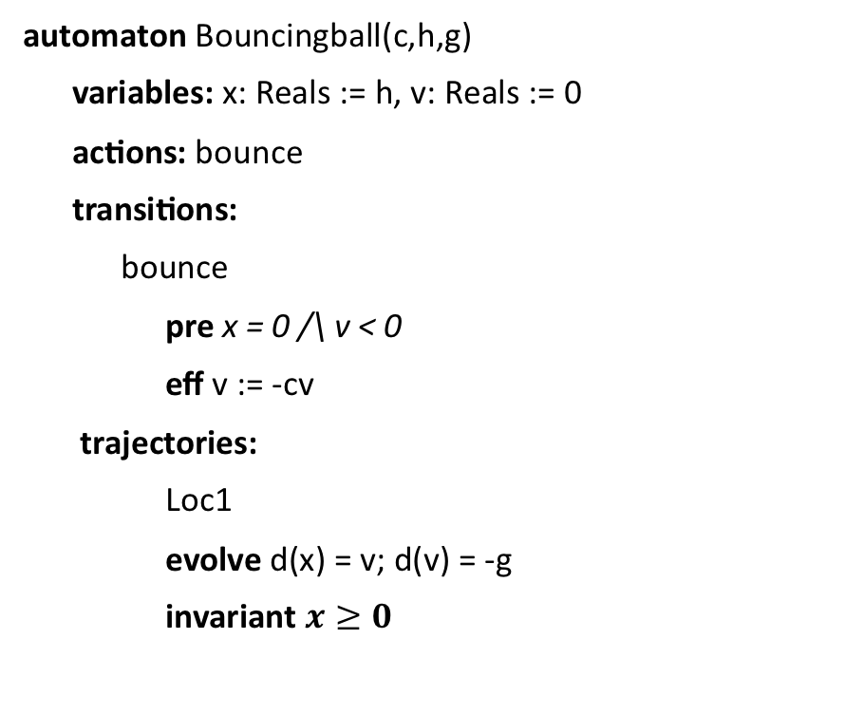
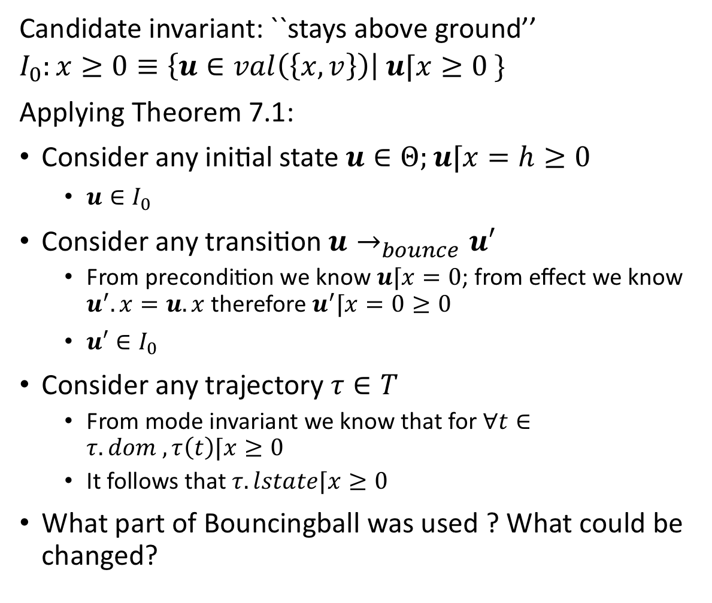
An application
Candidate invariant: ``stays above ground’’
$$I_{0}:x≥0≡\left\{u∈val\left(\left\{x,v\right\}\right)\right| u⌈x≥0 \}$$
Applying Theorem 7.1:
Consider any initial state $u∈Θ;u⌈x=h≥0$
$u∈I_{0}$
Consider any transition $u→_{bounce}u′$
From precondition we know $u⌈x=0$; from effect we know $u^{′}.x=u.x$ therefore $u^{′}⌈x=0≥0$
$u′∈I_{0}$
Consider any trajectory $τ∈T$
From mode invariant we know that for $∀t∈τ. dom , τ\left(t\right)⌈x≥0$
It follows that $τ.lstate⌈x≥0$
What part of Bouncingball was used ? What could be changed?
automaton Bouncingball(c,h,g)
variables: x: Reals := h, v: Reals := 0
actions: bounce
transitions:
bounce
pre x = 0 /\ v < 0
eff v := -cv
trajectories:
Loc1
evolve d(x) = v; d(v) = -g
invariant $x≥0$

Slide 6
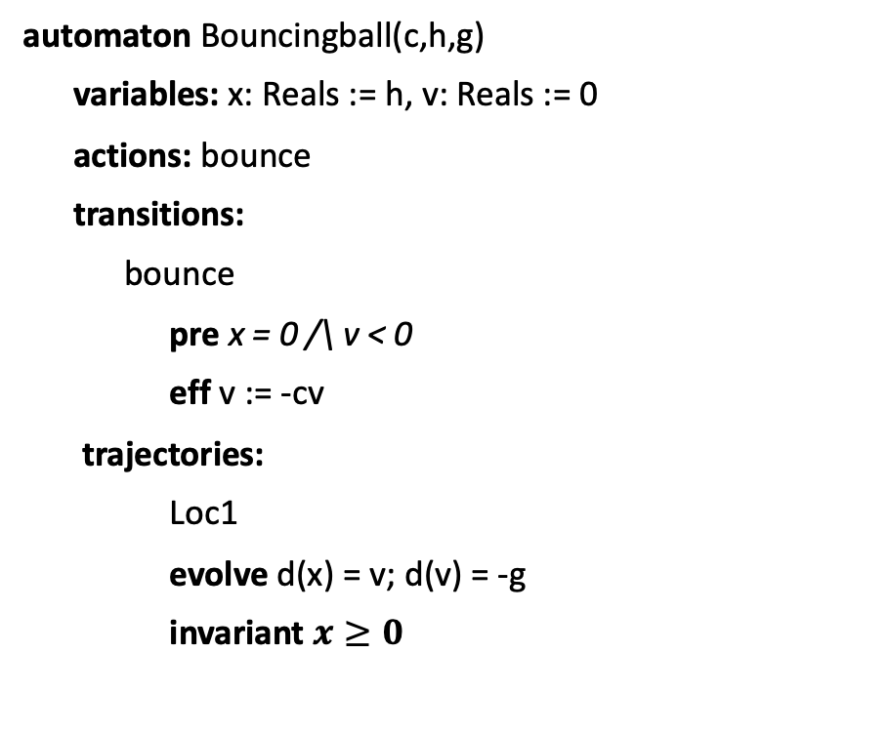
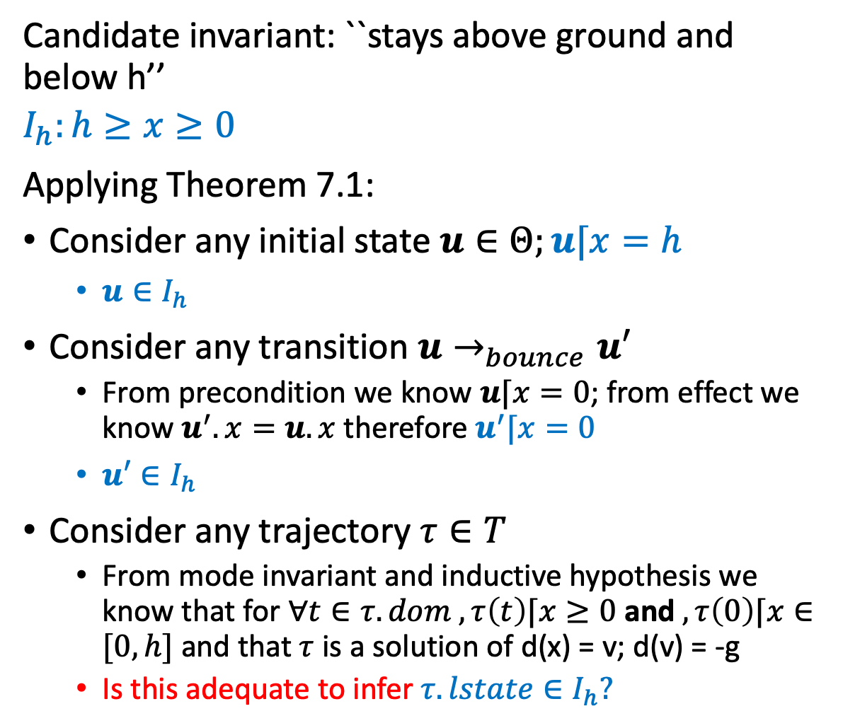
An application
Candidate invariant: ``stays above ground and below h’’
$$I_{h}:h≥x≥0$$
Applying Theorem 7.1:
Consider any initial state $u∈Θ;u⌈x=h$
$u∈I_{h}$
Consider any transition $u→_{bounce}u′$
From precondition we know $u⌈x=0$; from effect we know $u^{′}.x=u.x$ therefore $u^{′}⌈x=0$
$u′∈I_{h}$
Consider any trajectory $τ∈T$
From mode invariant and inductive hypothesis we know that for $∀t∈τ. dom , τ\left(t\right)⌈x≥0$ and $, τ\left(0\right)⌈x∈[0,h]$ and that $τ$ is a solution of d(x) = v; d(v) = -g
Is this adequate to infer $τ. lstate∈I_{h}?$
automaton Bouncingball(c,h,g)
variables: x: Reals := h, v: Reals := 0
actions: bounce
transitions:
bounce
pre x = 0 /\ v < 0
eff v := -cv
trajectories:
Loc1
evolve d(x) = v; d(v) = -g
invariant $x≥0$

Slide 7
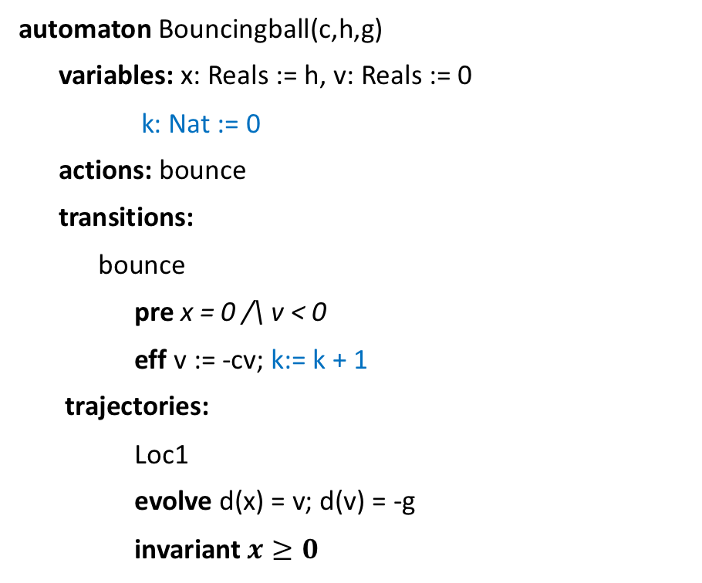
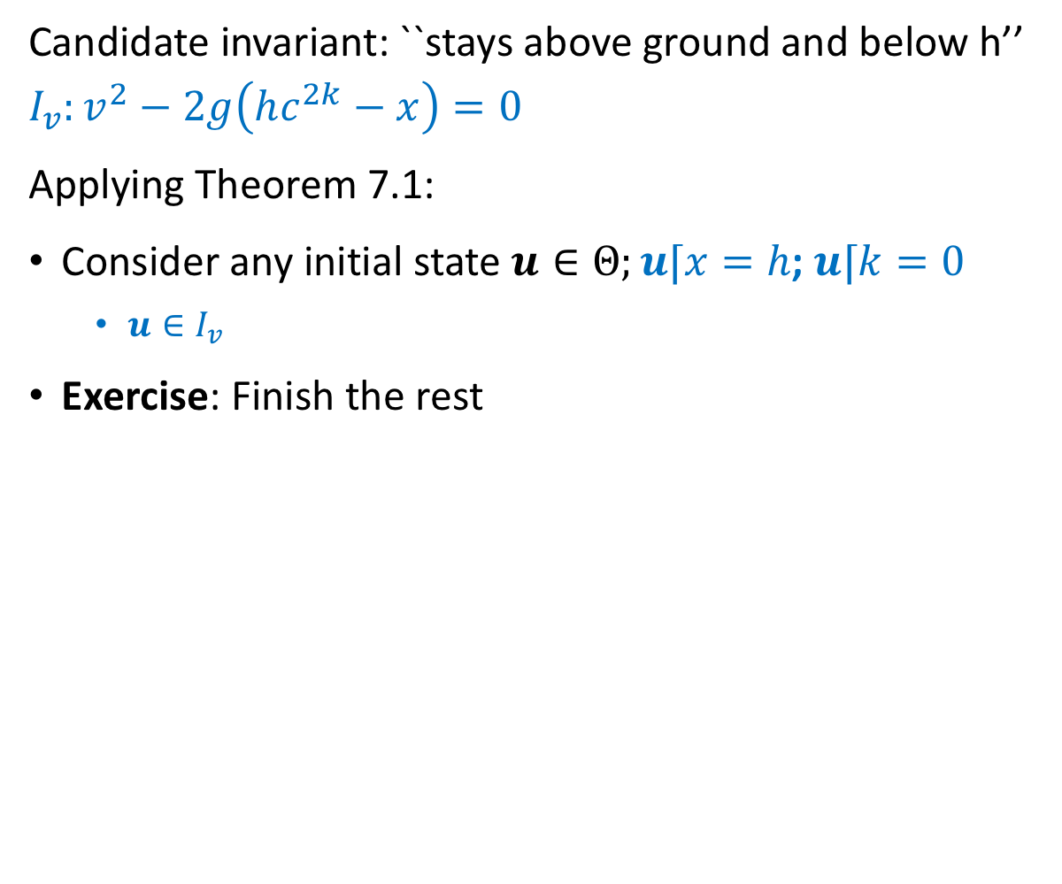
Strengthened invariant
Candidate invariant: ``stays above ground and below h’’
$$I_{v}:v^{2}−2g\left(hc^{2k}−x\right)=0$$
Applying Theorem 7.1:
Consider any initial state $u∈Θ;u⌈x=h$; $u⌈k=0$
$u∈I_{v}$
Exercise: Finish the rest
automaton Bouncingball(c,h,g)
variables: x: Reals := h, v: Reals := 0
k: Nat := 0
actions: bounce
transitions:
bounce
pre x = 0 /\ v < 0
eff v := -cv; k:= k + 1
trajectories:
Loc1
evolve d(x) = v; d(v) = -g
invariant $x≥0$

Slide 8
Summary
Theorem 7.1 gives a sufficient condition for proving inductive invariants
Not all invariants are inductive
We often have to strengthen invariants to make them inductive
Read examples in Chapter 7

Slide 9
Floyd-Hoare Proofs
The core idea of inductive invariants dates back to program analysis technique called Floyd-Hoare logic (1969) which gives a set of rules for deducing correctness of automata, programs
The logic is built on Hoare triples, which describes how the execution of a statement (or line of code) changes the state of the automaton:
P c Q where
P and Q are predicates on the program variables and are called the precondition and postcondition
c is a statement describing program variable change
The triple implies that when the precondition P is met, execution of c establishes the postcondition Q

Slide 10

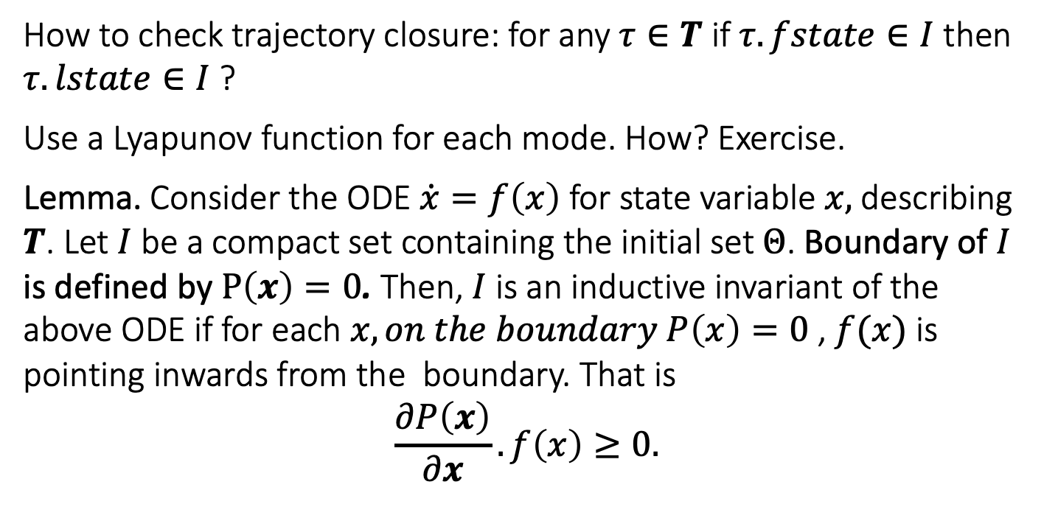


Sub-tangential conditions. Checking trajectory conditions without solving ODEs [Bhatia and Szegö 67]
How to check trajectory closure: for any $τ∈T$ if $τ.fstate∈I$ then $τ.lstate∈I$ ?
Use a Lyapunov function for each mode. How? Exercise.
Lemma. Consider the ODE $\dot{x}=f\left(x\right)$ for state variable $x,$ describing $T$. Let $I$ be a compact set containing the initial set $Θ$. Boundary of $I$ is defined by $P\left(x\right)=0$. Then, $I$ is an inductive invariant of the above ODE if for each $x,on the boundary P\left(x\right)=0$ , $f(x)$ is pointing inwards from the boundary. That is
$$\frac{∂P\left(x\right)}{∂x}.f\left(x\right)≥0.$$
$$f(x)$$
$$I$$
$$P\left(x\right)=0$$
Related to the notions of Barrier Certificates and more general Control Barrier Functions.

Slide 11
Checking sub-tangential condition in pieces
If the boundary is defined in pieces, for example, one fore each mode, then check the condition for each piece

Slide 12


Summary
Interesting features (or possible bugs) in hybrid models
Interaction between transitions, trajectories, and mode invariants can lead to extra sources of nondeterminism; transitions can be made urgent with mode invariants
Mode switches can make the system unstable
Zeno behavior
Inductive invariance proofs work with additional condition for trajectory closure
Trajectory closure can be checked with subtangential condition, Lyapunov functions, Barrier certificates

